Slide 1

Oracle12c: SQL
Chapter 12
Subqueries and Merge Statements
©2016. Cengage Learning. All rights reserved.

Slide 2
Objectives
Determine when using a subquery is appropriate
Identify which clauses can contain subqueries
Distinguish between an outer query and a subquery
Use a single-row subquery in a WHERE clause
Use a single-row subquery in a HAVING clause
Use a single-row subquery in a SELECT clause
©2016. Cengage Learning. All rights reserved.

Slide 3
Objectives (continued)
Distinguish between single-row and multiple-row comparison operators
Use a multiple-row subquery in a WHERE clause
Use a multiple-row subquery in a HAVING clause
Use a multiple-column subquery in a WHERE clause
©2016. Cengage Learning. All rights reserved.

Slide 4
Objectives (continued)
Create an inline view using a multiple-column subquery in a FROM clause
Compensate for NULL values in subqueries
Distinguish between correlated and uncorrelated subqueries
Nest a subquery inside another subquery
Use a subquery in a DML action
Process multiple DML actions with a MERGE statement
©2016. Cengage Learning. All rights reserved.

Slide 5
Subqueries and Their Uses
Subquery – a query nested inside another query
Used when a query is based on an unknown value
Requires SELECT and FROM clauses
Must be enclosed in parentheses
Place on right side of comparison operator
©2016. Cengage Learning. All rights reserved.

Slide 6
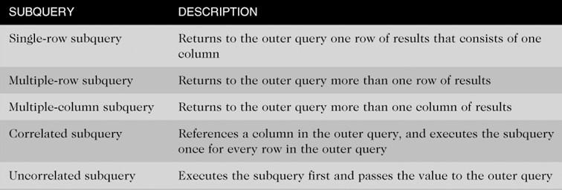
Types of Subqueries
©2016. Cengage Learning. All rights reserved.

Slide 7
Single-Row Subqueries
Can only return one result to the outer query
Operators include =, >, <, >=, <=, < >
©2016. Cengage Learning. All rights reserved.

Slide 8
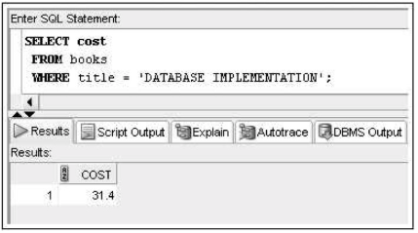
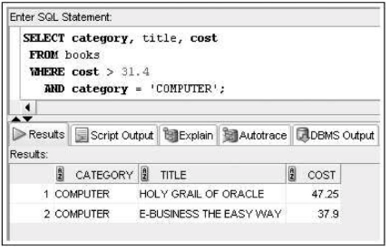
Let’s say management requested a list of all computer books with a higher retail price than the book Database Implementation.

Slide 9
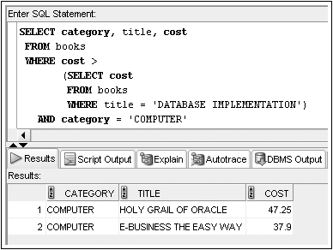
Single-Row Subquery in a WHERE Clause
Used for comparison against individual data
©2016. Cengage Learning. All rights reserved.

Slide 10
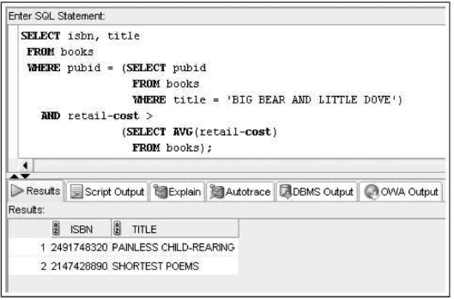
Suppose management needs to know the title of all books published by the publisher of Big Bear & Little Dove that generate more than the average profit returned by all books sold by JustLee Books.
Two values are unknown:
  the identity of the publisher of Big Bear & Little Dove
  the average profit of all books

Slide 11
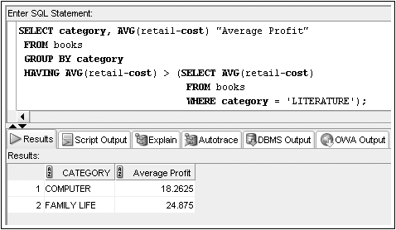
Single-Row Subquery in a HAVING Clause
Required when returned value is compared to grouped data
©2016. Cengage Learning. All rights reserved.

Slide 12
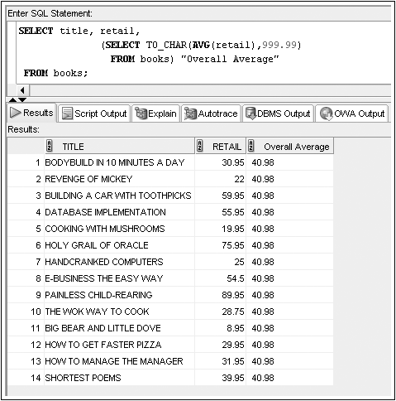
Single-Row Subquery in a SELECT Clause
Replicates subquery value for each row displayed
©2016. Cengage Learning. All rights reserved.

Slide 13
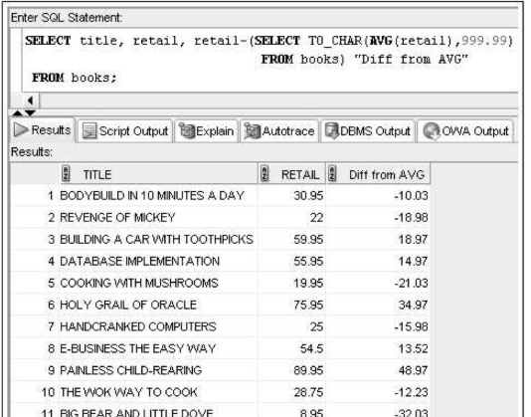

Slide 14
Multiple-Row Subqueries
Return more than one row of results
Require use of IN, ANY, ALL, or EXISTS operators
©2016. Cengage Learning. All rights reserved.

Slide 15
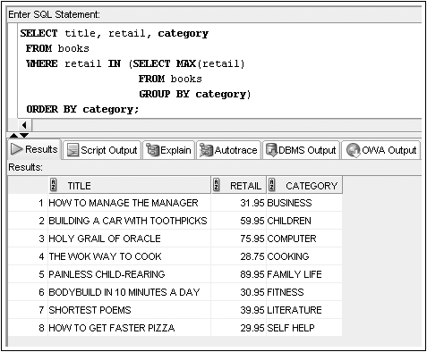
Multiple-Row Subquery in a WHERE Clause
Note: Could use IN operator or =ANY
©2016. Cengage Learning. All rights reserved.

Slide 16
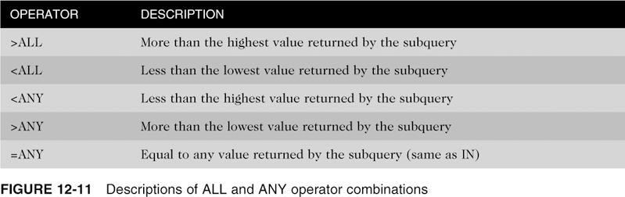
ANY and ALL Operators
Combine with arithmetic operators
©2016. Cengage Learning. All rights reserved.

Slide 17
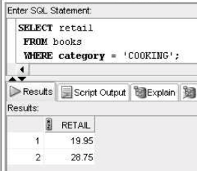
Look at this query. . . .it returns the retail prices for two books in the Cooking category. The lowest value returned is $19.95, and the highest value is $28.75.

Slide 18
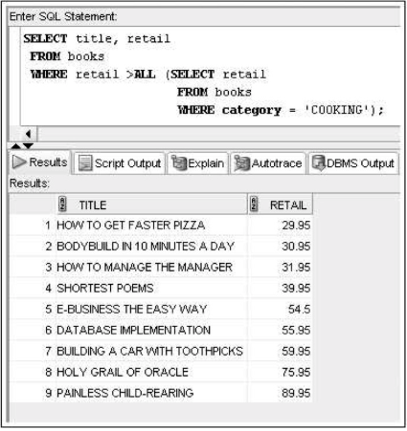
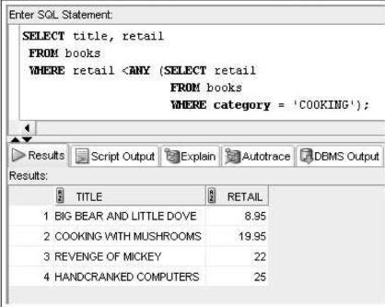
Suppose you want to know the titles of all books having a retail price greater than the most expensive book in the Cooking category.

Slide 19
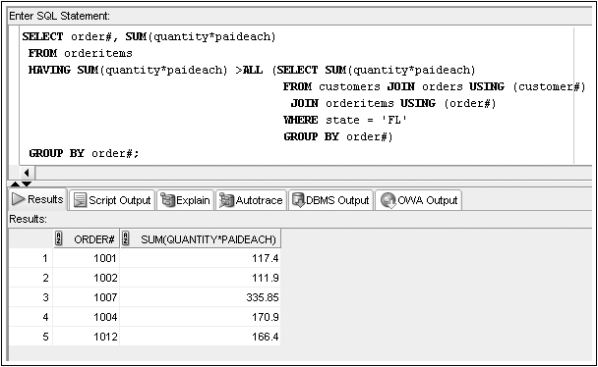
Multiple-Row Subquery in a HAVING Clause
The structure for using a multiple-row subquery in a HAVING clause is the same as using the subquery in a WHERE clause.

Slide 20
Multiple-Column Subqueries
Return more than one column in results
Can return more than one row
Column list on the left side of operator must be in parentheses
Use the IN operator for WHERE and HAVING clauses
©2016. Cengage Learning. All rights reserved.

Slide 21
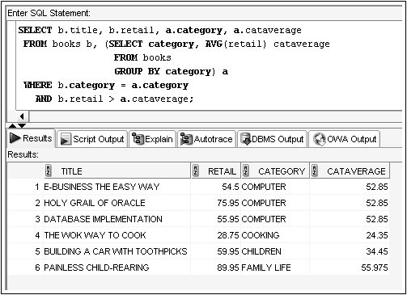
Multiple-Column Subquery in a FROM Clause
Creates a temporary table

Slide 22
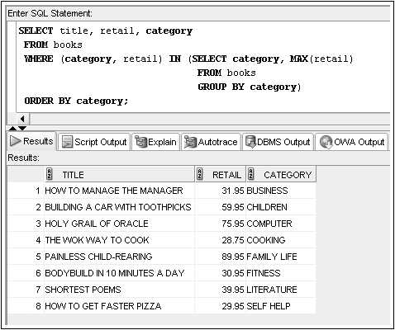
Multiple-Column Subquery in a WHERE Clause
Returns multiple columns for evaluation
©2016. Cengage Learning. All rights reserved.

Slide 23
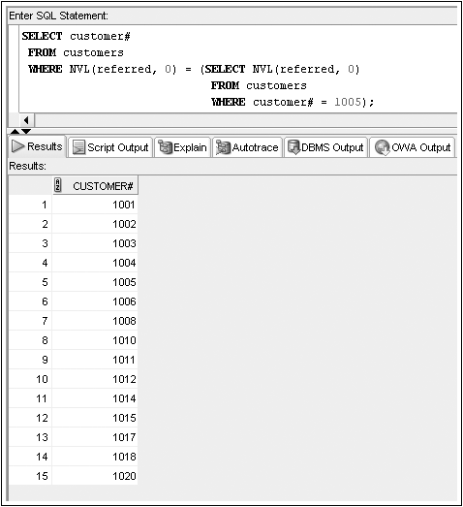
NULL Values
When a subquery might return NULL values, use NVL function
©2016. Cengage Learning. All rights reserved.

Slide 24
Uncorrelated Subqueries
Processing sequence
  Inner query is executed first
  Result is passed to outer query
  Outer query is executed
©2016. Cengage Learning. All rights reserved.

Slide 25
Correlated Subqueries
Inner query is executed once for each row processed by the outer query
Inner query references the row contained in the outer query
©2016. Cengage Learning. All rights reserved.

Slide 26
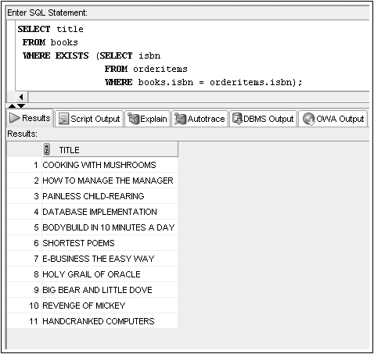
Correlated Subqueries (continued)
©2016. Cengage Learning. All rights reserved.

Slide 27
Nested Subqueries
Maximum of 255 subqueries if nested in the WHERE clause
No limit if nested in the FROM clause
Innermost subquery is resolved first, then the next level, etc.
©2016. Cengage Learning. All rights reserved.

Slide 28
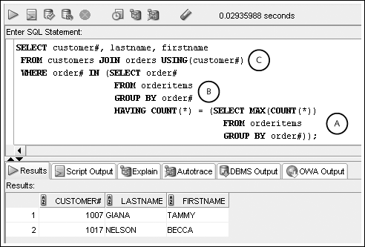
Nested Subqueries (continued)
Innermost is resolved first (A), then the second level (B), then the outer query (C)
©2016. Cengage Learning. All rights reserved.

Slide 29
Subquery Factoring Clause
WITH dcount AS (
SELECT deptno, COUNT(*) AS dcount
FROM employees
GROUP BY deptno)
SELECT e.lname Emp_Lastname,
e.deptno e_dept,
d1.dcount edept_count,
m.lname manager_name,
m.deptno mdept,
d2.dcount mdept_count
FROM employees e,
dcount d1,
employees m,
dcount d2
WHERE e.deptno = d1.deptno
AND e.mgr = m.empno
AND m.deptno = d2.deptno
AND e.mgr = '7839';
©2016. Cengage Learning. All rights reserved.

Slide 30
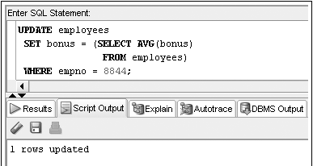
Subquery in a DML action
©2016. Cengage Learning. All rights reserved.

Slide 31
MERGE Statement
With a MERGE statement, a series of DML actions can occur with a single SQL statement
Conditionally updates one data source based on another
©2016. Cengage Learning. All rights reserved.

Slide 32
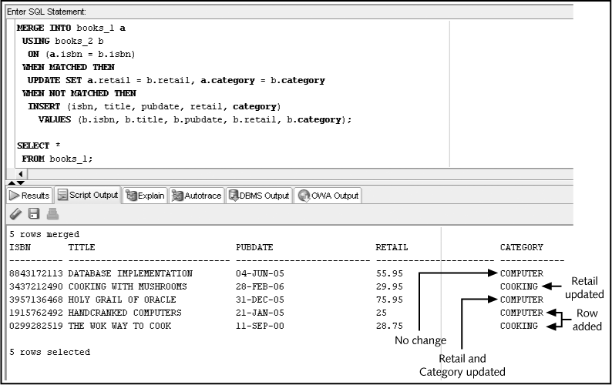
MERGE Statement (continued)
©2016. Cengage Learning. All rights reserved.

Slide 33
MERGE Statement (continued)
The following explains each part of the previous MERGE statement:
  MERGE INTO books_1 a: The BOOKS_1 table is to be changed and a table alias of “a” is assigned to this table
  USING books_2 b: The BOOKS_2 table will provide the data to update and/or insert into BOOKS_1 and a table alias of “b” is assigned to this table
  ON (a.isbn = b.isbn): The rows of the two tables will be joined or matched based on isbn
  WHEN MATCHED THEN: If a row match based on ISBN is discovered, execute the UPDATE action in this clause. The UPDATE action instructs the system to modify only two columns (Retail and Category)
  WHEN NOT MATCHED THEN: If no match is found based on the ISBN (a books exists in BOOKS_2 that is not in BOOKS_1), then perform the INSERT action in this clause
©2016. Cengage Learning. All rights reserved.

Slide 34
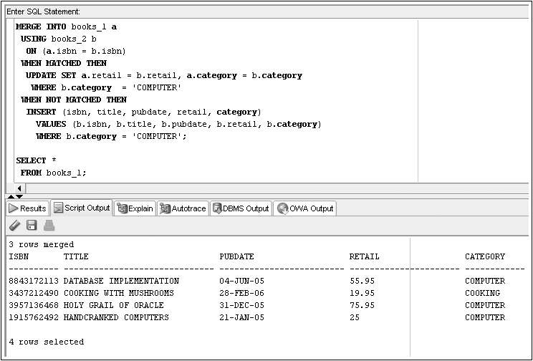
MERGE with WHERE conditions
©2016. Cengage Learning. All rights reserved.

Slide 35
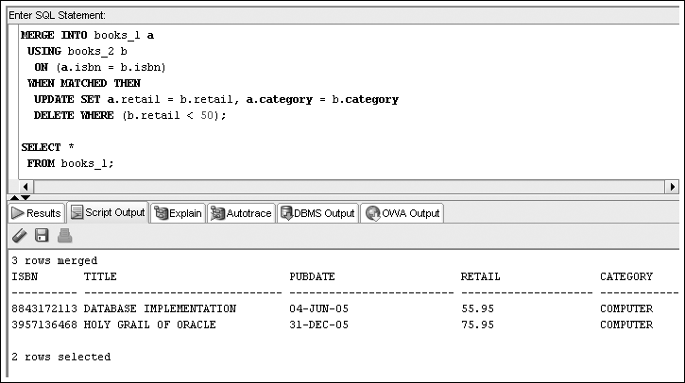
MERGE with DELETE
©2016. Cengage Learning. All rights reserved.

Slide 36
Summary
A subquery is a complete query nested in the SELECT, FROM, HAVING, or WHERE clause of another query
  The subquery must be enclosed in parentheses and have a SELECT and a FROM clause, at a minimum
Subqueries are completed first; the result of the subquery is used as input for the outer query
A single-row subquery can return a maximum of one value
Single-row operators include =, >, <, >=, <=, and <>
Multiple-row subqueries return more than one row of results
©2016. Cengage Learning. All rights reserved.

Slide 37
Summary (continued)
Operators that can be used with multiple-row subqueries include IN, ALL, ANY, and EXISTS
Multiple-column subqueries return more than one column to the outer query
NULL values returned by a multiple-row or multiple-column subquery will not present a problem if the IN or =ANY operator is used
Correlated subqueries reference a column contained in the outer query
Subqueries can be nested to a maximum depth of 255 subqueries in the WHERE clause of the parent query
©2016. Cengage Learning. All rights reserved.

Slide 38
Summary (continued)
With nested subqueries, the innermost subquery is executed first, then the next highest level subquery is executed, and so on, until the outermost query is reached
A MERGE statement allows multiple DML actions to be conditionally performed while comparing data of two tables
©2016. Cengage Learning. All rights reserved.

